Slide 1
OFF THE BEATEN PATH:
Best Practices for Librarians and Library Paraprofessionals

Slide 2
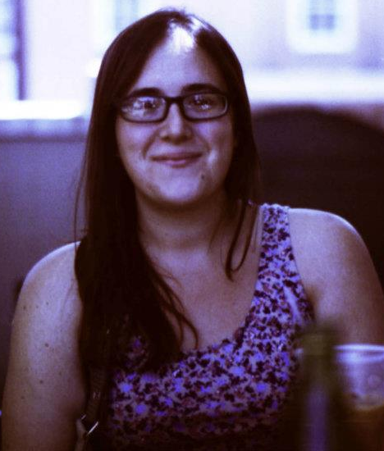
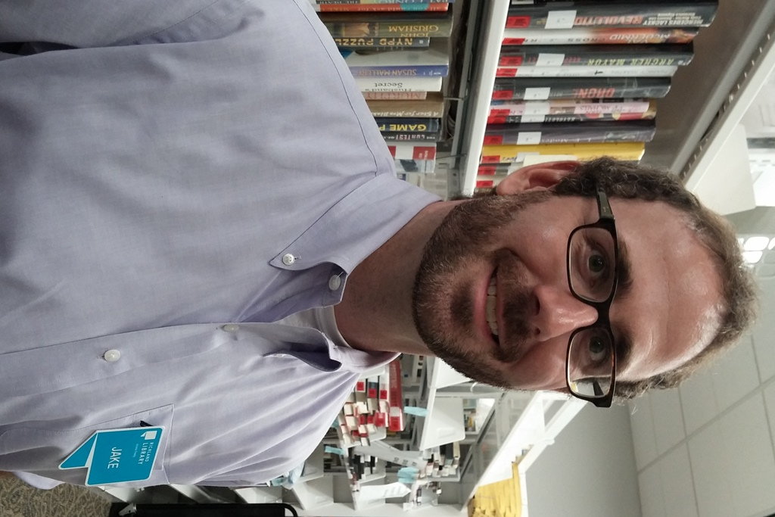
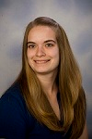
PRESENTERS
Jake Duffie
Assistant Manager,
Richland Library Southeast
Megan Summers
Reference Assistant,
Charleston County Public Library
Breanne Kirsch
Public Services Librarian,
USC Upstate Library

Slide 3
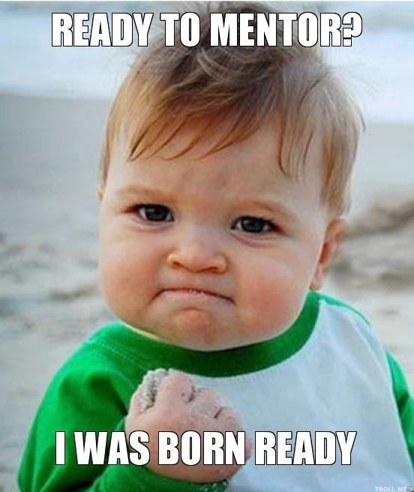
1. FINDING A MENTOR

Slide 4
How Can I Find a Professional Mentor in the Library Field?
1. Work Organizations:
- Committees and Groups
- Staff Organizations
2. Library Groups:
- Committees
- Round Tables
- Mentoring Programs
3. Annual Conferences:
- Socials
- Seminars
4. SLIS Programs:
- USC
- Need to be ALA- Accredited

Slide 5

2. READING THE LITERATURE

Slide 6
How Do I Get Access to Relevant Literature for Librarians?
1. Scholarly Journals and Trade Publications
- American Libraries
- Booklist
- Library Hotline
- Public Libraries
- Library Journal
- Journal of Academic Librarianship
- College & Research Libraries
- School Library Journal
- Publisher’s Weekly
2. Email
- Newsletters: AL Direct, Staff Newsletters
- Listservs
- Groups: SCLA
3. Social Media
- Twitter
- Facebook
- Instagram

Slide 7
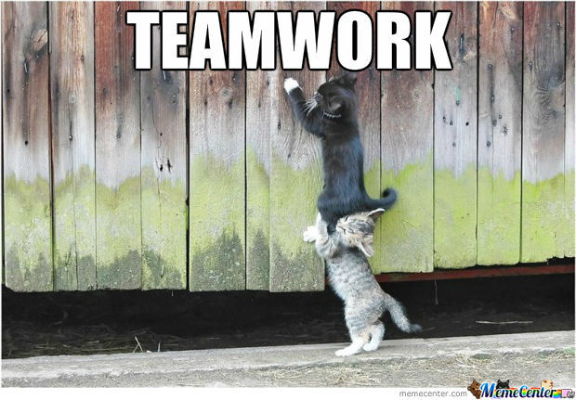
3. COLLABORATION & TEAMWORK

Slide 8
Why is Teamwork So Important?
- Enhanced Knowledge
- Efficiency
- Highlight Your Skills
- Favor Economy

Slide 9
How Do I Collaborate?
- Broadcast your willingness to help, informally or through management.
- Go Beyond your Building Walls
- Make your own Team

Slide 10
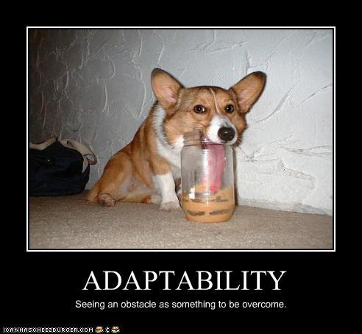
4. ADAPTABILITY & FLEXIBILITY

Slide 11
Why Should I Be Flexible?
- Libraries (and the world) are in a constant state of flux.
- Necessary 21st century professional skill.
- Adaptability makes it easier to move between jobs.
- Don’t get left behind.
- Varied Patron/Customer Needs
- Vital to collaboration.

Slide 12
How Can I Adapt?
- Focus on the importance and the benefits of flexibility.
- Make a conscious effort to absorb new ideas, insights.
- Deliberate cross-training.
- Avoid becoming “too” specialized.
- Relax!

Slide 13
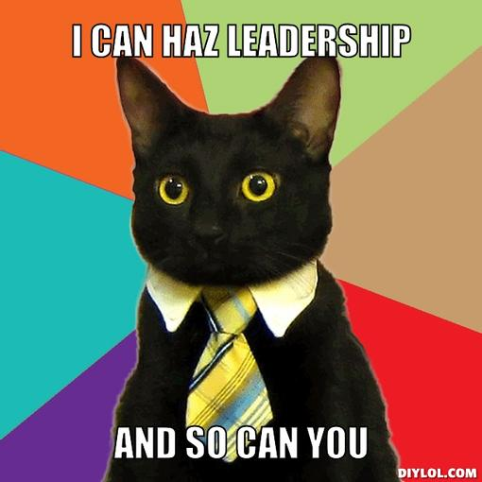
5. BECOME A LEADER

Slide 14
What Makes a Good Leader?
- Initiative
- Innovation
- Proactive
- Results Oriented

Slide 15
Leadership Roles
- “Leadership is not just a matter of position or authority; it should occur at multiple levels within an organization.” – DeLong, 2009
- “Good Leadership skills will enhance any librarian’s individual career and the profession as a whole.” – Cromer, 2009
- “Self-awareness is considered one of the first areas to focus on when planning one’s own leadership growth.” – Watson, 2014

Slide 16
Examples
- Technology Competency Requirement
- Digital Library Metadata
- Plagiarism Prevention Workshops
- Leisure Reading Collection
- Workshops Day for Librarians and Educators
- Library Games Committee

Slide 17
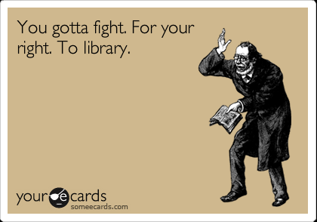
6. BE PERSISTENT

Slide 18
Challenges/Obstacles
- Request for a new program or instruction session.
- Monotony- Plagiarism Prevention Workshops example.
- Too many spinning plates.

Slide 19
Avoid Burnout
- Specialize in one or two areas and then change focus every so often.
- Try something new- attend workshops and conferences to gain new ideas.
- Exercise and healthy eating.
- Change is good.

Slide 20
Sources
Caputo, J. (1991). Stress and Burnout in Library Service. Phoenix, Arizona: Oryx Press.
Cromer, D. E. (2009). Special Libraries Association: The Importance of Leadership. Journal Of Library Administration, 49(8), 887-893. doi:10.1080/01930820903397226
DeLong, K. (2009). The Engagement of New Library Professionals in Leadership. Journal Of Academic Librarianship, 35(5), 445-456.
Watson, J. (2014). Be A Leader by Knowing Yourself. Young Adult Library Services, 12(2), 4-5.

Slide 21
QUESTIONS?

